Slide 1
FAKE NEWS DETECTION SYSTEM
MSc Computer Science
Year 2020
Presented By
Harika Kudarvalli (0887033)
Supervisor
Dr. Jinan Fiaidhi

Slide 2
OUTLINE
Introduction
Web Scraping
Dataset
Flowchart
Preprocessing
Tokenization
Feature Extraction
Training Classifiers
Logistic Régression
Naive Bayes
Support Vector Machine
Long Short-Term Memory
Comparisons
Challenges
Conclusion
To Conclude
Future Work
References

Slide 3

INTRODUCTION
More than 3 billion people in the world are dependent on various social media platforms for daily news updates.
These sites not only act as a platform for staying connected with friends but also to share information over the internet.
Is all the information over the social media credible and trustworthy?
With the flexibility of anyone can share anything over the platform, social media is more prone to the spread of irrelevant and misleading information.
Notes:
Give example of Hantavirus

Slide 4
INTRODUCTION
Fake News Detection in FACEBOOK
Third – party fact checking organizations.
Strict enforcement of policies for purchasing ads.
Machine Learning to detect spam accounts.
Takes users reviews into consideration and ranks their reviews.
Facebook Journalism Project .
News Integrity Initiative.
Notes:
Platform for journalists and anchors to help in fact checking
Multiple organizations around the world

Slide 5
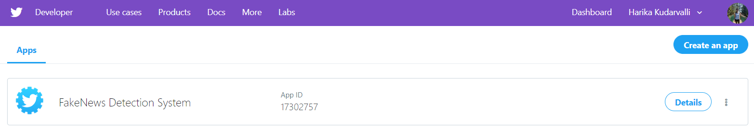
WEB SCRAPING
Create a Twitter Developers Account
Once approved, create an app with desired name.

Slide 6
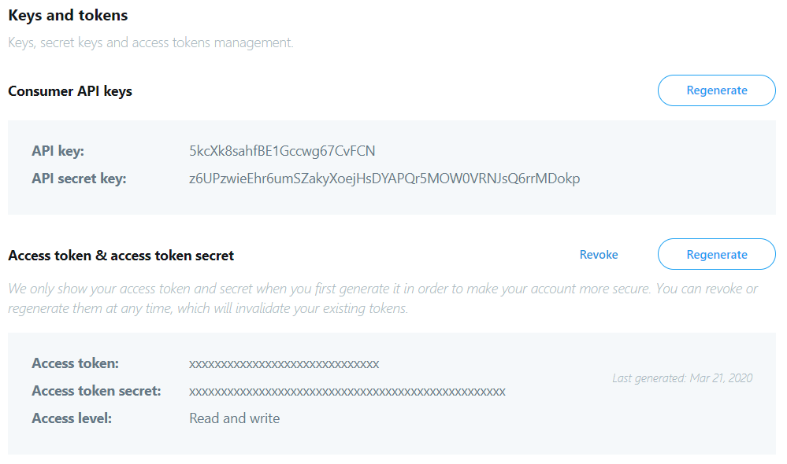
WEB SCRAPING
3. Twitter will provide following credentials for users to validate their scraping requests.

Slide 7
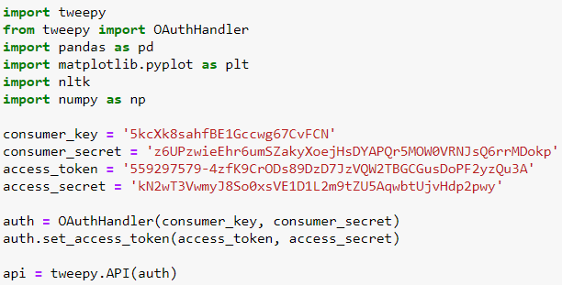
WEB SCRAPING

Slide 8
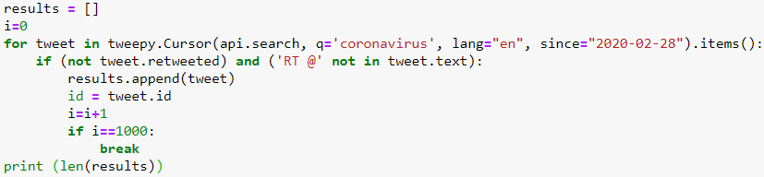
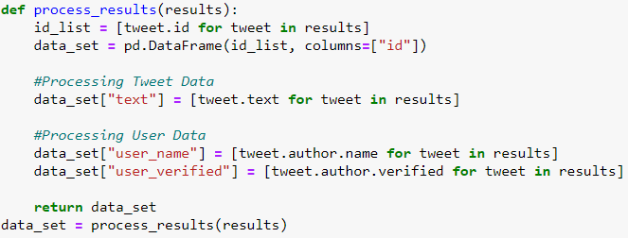
WEB SCRAPING
Scraping Parameters
Extracting User Information

Slide 9
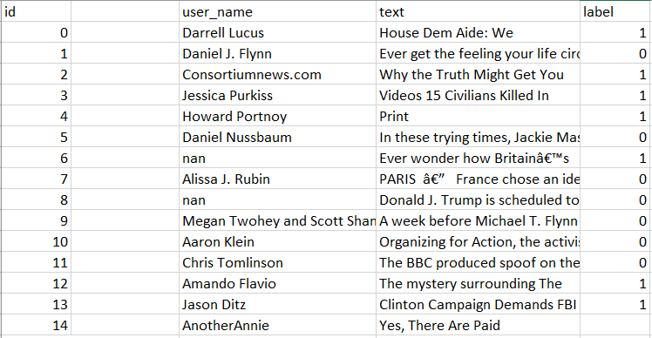
DATASET
Id – unique identification to individual text
User_name – Name of the author
Text – Tweet information
Label (1) – Fake
Label (0) - Real
Notes:
If user is verified, then add label as 0 else 1

Slide 10
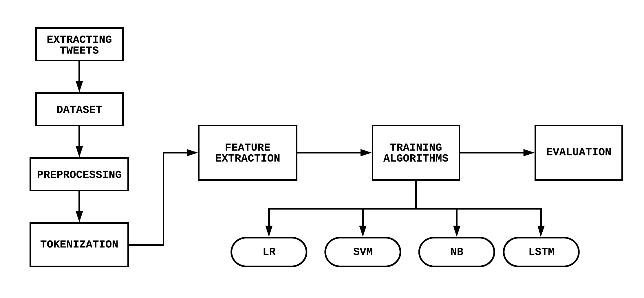
FLOWCHART
Source: www.lucidcharts.com

Slide 11
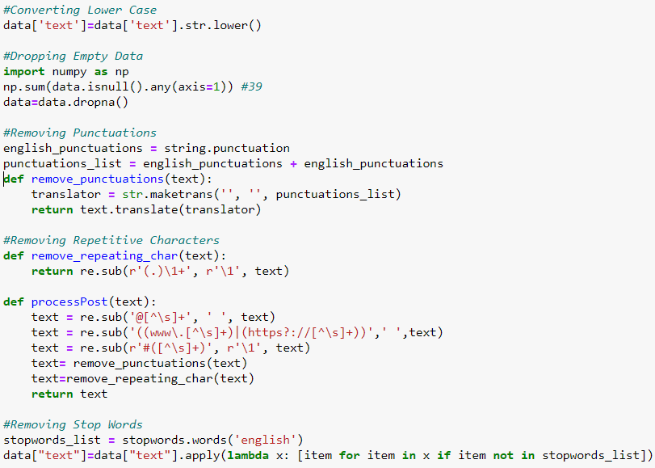
PREPROCESSING
Lower case
Stop words
Empty columns
Punctuations
Repeating characters

Slide 12

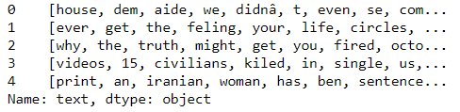
TOKENIZATION
RegexTokenizer
A regex - based tokenizer that extracts tokens either by using the provided regex pattern to split the text (default) or repeatedly matching the regex (if gaps is false). Optional parameters also allow filtering tokens using a minimal length. It returns an array of strings that can be empty.

Slide 13
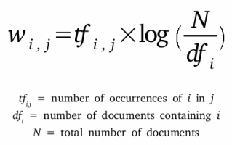
FEATURE EXTRACTION
Term Frequency – Inverse Document Frequency (TF-IDF)
The TfidfVectorizer will tokenize documents, learn the vocabulary and inverse document frequency weightings, and allow you to encode new documents.
Term Frequency: This summarizes how often a given word appears within a document.
Inverse Document Frequency: This downscales words that appear a lot across documents.
Notes:
Many tokenizing methods count frequent words like the and and give more count to overcome that tfidf

Slide 14
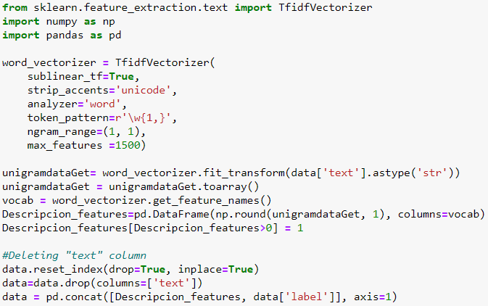
FEATURE EXTRACTION

Slide 15
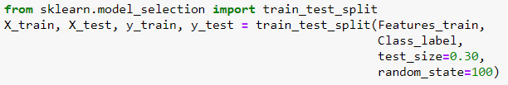
TRAINING CLASSIFIERS
Splitting entire dataset into training and testing set.
Training Data – 70%
Testing Data – 30%
Logistic Regression
Naïve Bayes
Long Short-Term Memory
Support Vector Machine

Slide 16
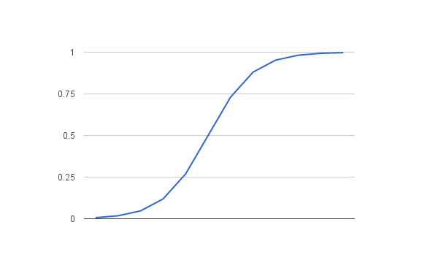

LOGISTIC REGRESSION
Machine Learning classification algorithm that is used to predict the probability of a categorical dependent variable.
Dependent variable is a binary variable that contains data coded as 1 (yes, success, etc.) or 0 (no, failure, etc.)
LR Hypothesis
Notes:
Logistic regression requires quite large sample sizes.
meaningful variables should be included
Logistic Regression a Linear Regression model but the Logistic Regression uses a more complex cost function, this cost function can be defined as the ‘Sigmoid function
The hypothesis of logistic regression tends it to limit the cost function between 0 and 1. Therefore linear functions fail to represent it as it can have a value greater than 1 or less than 0 which is not possible as per the hypothesis of logistic regression.
In the image it’s a range of values from 0-1

Slide 17
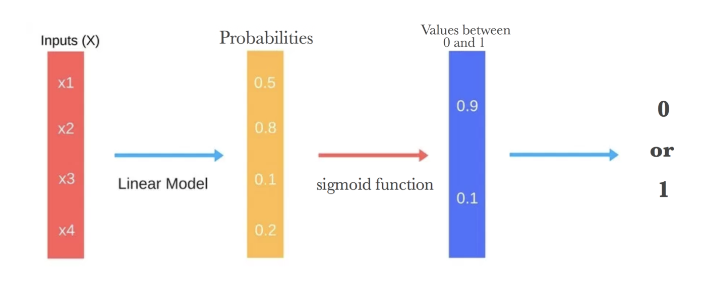
LOGISTIC REGRESSION
Logistic Regression can be classified as:
Binomial
Multinomial
Ordinal
Advantages:
Overfitting
Direction of association
Disadvantages:
Number of features
Assumption of linearity
Notes:
Advantages
Less prone to overfitting for high dimensional data
Gives a measure of how relevant a predictor (coefficient size) is, but also its direction of association (positive or negative).
Disadvantages
number of observations are lesser than the number of features – don’t use
assumption of linearity between the dependent variable and the independent variables

Slide 18
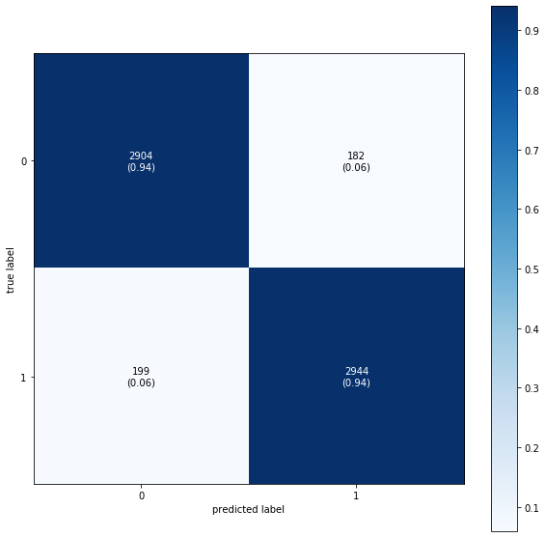
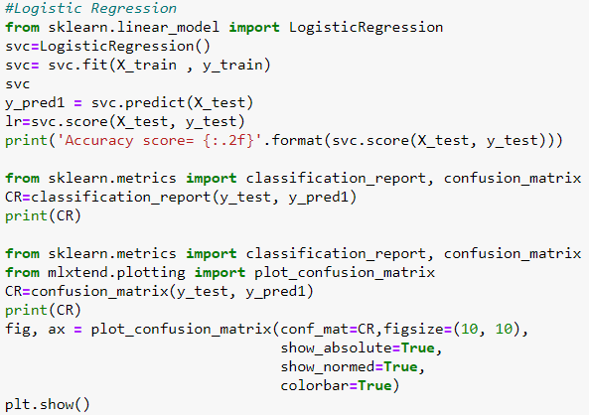
LOGISTIC REGRESSION

Slide 19
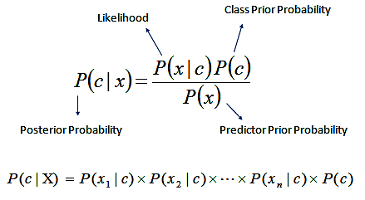
NAÏVE BAYES
A Naive Bayes classifier is a probabilistic machine learning model that’s used for classification task.
The crux of the classifier is based on the Bayes theorem.
Assumptions:
Predictors are independent
All the predictors have an equal effect on the outcome

Slide 20
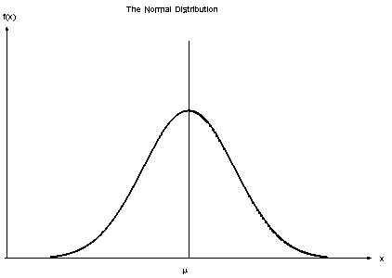
NAÏVE BAYES
Naïve Bayes can be classified as:
Multinomial
Bernoulli
Gaussian
Advantages:
Independent predictors
Training data
Disadvantages:
Assumption of independent predictors
Zero frequency
Notes:
Multinomial – document classification like categories of sports entertainment
Bernouii – similar to above but Boolean classification like yes or no
Gaussian – continuous value
Advantages
independent predictors holds true, a Naive Bayes classifier performs better as compared to other models
small amount of training data given less training time
If categorical variable has a category in test data set, which was not observed in training data set, then model will assign a 0 (zero) probability and will be unable to make a prediction (smoothing technique)

Slide 21
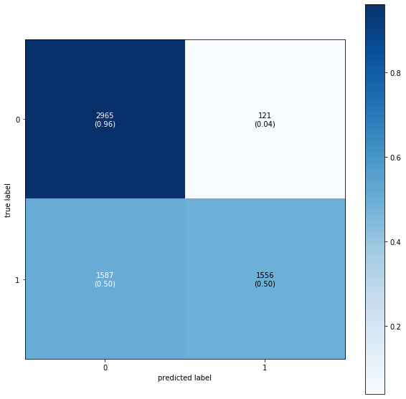
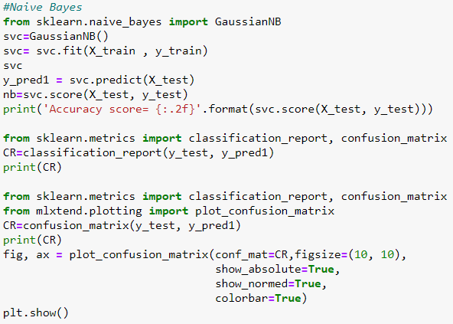
NAÏVE BAYES

Slide 22
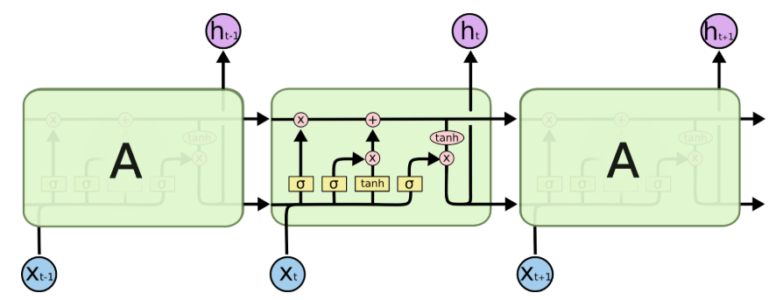
LONG SHORT-TERM MEMORY
Artificial Recursive Neural Network
A common LSTM unit is composed of a cell, an input gate, an output gate and a forget gate
Source - https://www.knime.com/blog/text-generation-with-lstm
Notes:
RNN has a problem with long short term memory where it can remember large sequence of data and might leave out important features\
The cell remembers values over arbitrary time intervals and the three gates regulate the flow of information into and out of the cell.
language translations to predicting your next word on your iPhone’s keyboard
Introduced to solve vanishing and exploding gradient in RNN.
Rather than storing entire history, LSTM can selectively remember & forget data.
Memory blocks – storing, Gates – manipulation (forget, input, output)
Longer to run and deplete more memory

Slide 23
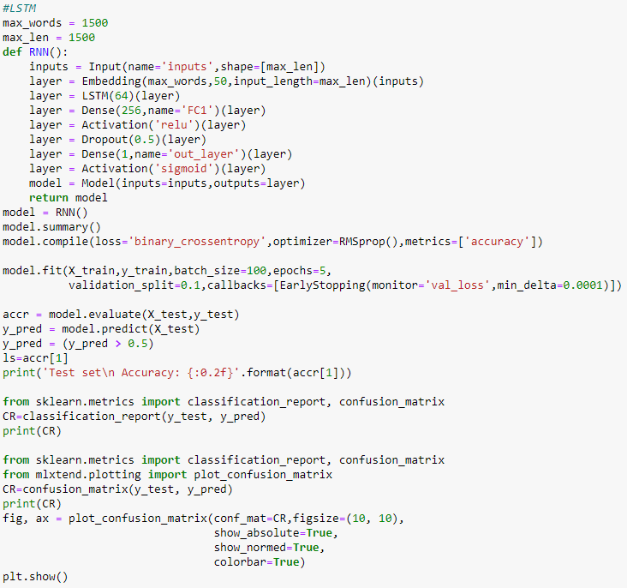
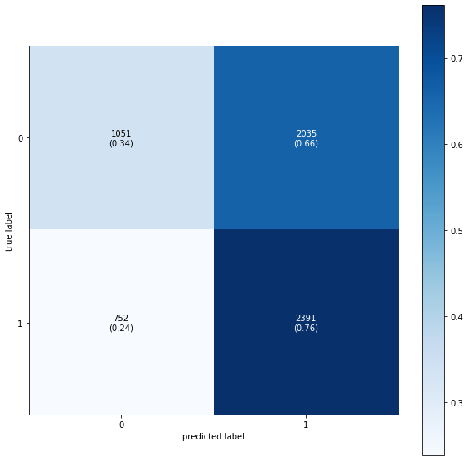
LONG SHORT-TERM MEMORY
Notes:
Embedding layer is used to create word vectors for incoming words
A fully connected layer that often follows LSTM layers and is used for outputting a prediction is called Dense()
an activation is required between matrix multiplications to afford a neural network the ability to model non-linear processes
Dropout is a regularization method where input and recurrent connections to LSTM units are probabilistically excluded from activation and weight updates while training a network. This has the effect of reducing overfitting and improving model performance.
RMSprp- based on Stochastic Gradient Descent. decide the learning rate and gradient
Earlystopping- number of training epochs and stop training once the model performance stops improving on a hold out validation dataset.

Slide 24
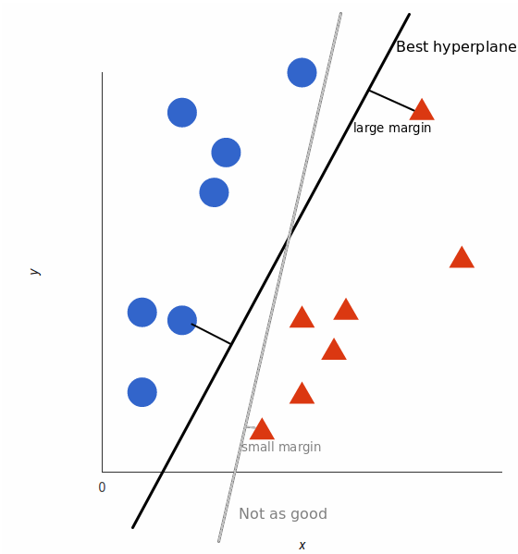
SUPPORT VECTOR MACHINE
Supervised machine learning model.
Decision Boundary - takes these data points and outputs the hyperplane that best separates the tags.
Best Hyperplane - one that maximizes the margins from both tags.

Slide 25
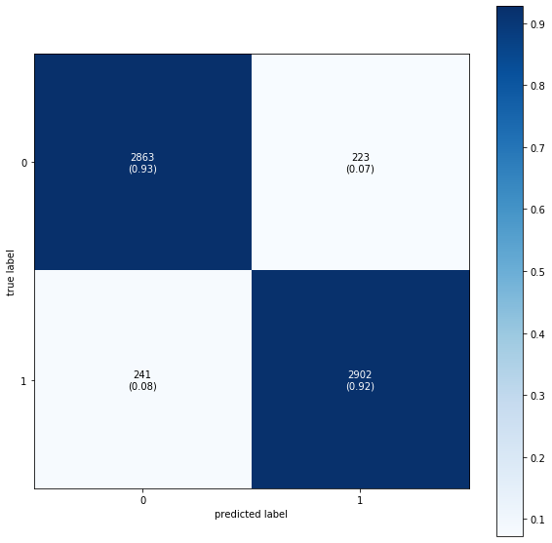
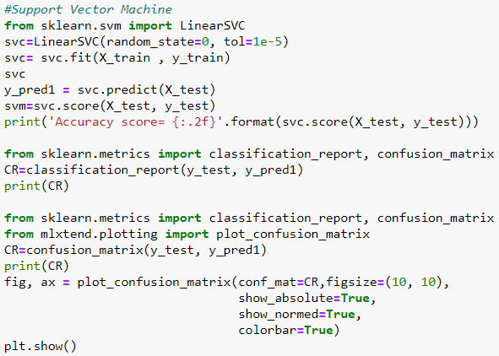
SUPPORT VECTOR MACHINE
Notes:
Support vector classifier
Tol – tolerance for stopping criteria

Slide 26
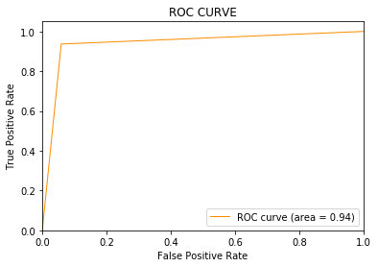

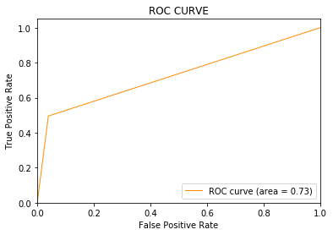
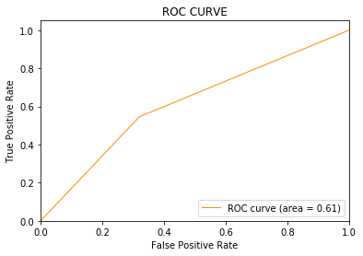
ROC CURVES
Logistic Regression
SVM
Naïve Bayes
LSTM
Notes:
Receiver Operator Characteristic (ROC) curve

Slide 27
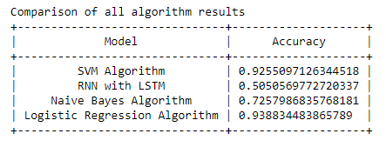
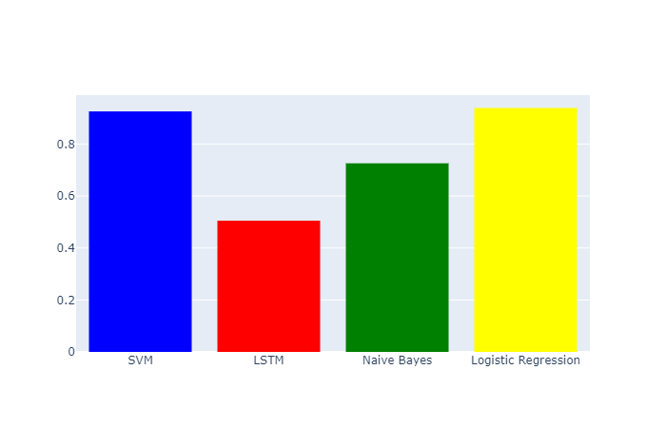
COMPARISON
Notes:
LR is good for classification problems and a good baseline model. (fast to train and tune, interpretable, flexible)
RNN – worst as neural networks best with images (maybe better with bag of words)
neural networks wonders with unstructured data.

Slide 28
CHALLENGES
Twitter restricts extracting more than 500 tweets in 15 mins.
Label each tweet dynamically.
Considering multiple parameters.
No absolute credible sources to do automatic fact check.
Facebook, Twitter, Google are still rolling out beta features.

Slide 29
CONCLUSION
FUTURE WORK
Logistic Regression and Support Vector Machine perform the best with more than 90% accuracies.
Due to the booming development of online social networks, fake news for various commercial and political purposes has been appearing in large numbers and widespread in the online world.
Make fact checking and labelling dynamic (Sentiment Analysis).
Expand this research to deep learning algorithms.
Use different forms of data like photos and videos.

Slide 30
Thank You!
&
Stay Home!

